Slide 1
Basics of Statistics - I
Introduction and Descriptive Analytics
02nd Mar 2015

Slide 2
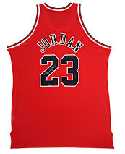
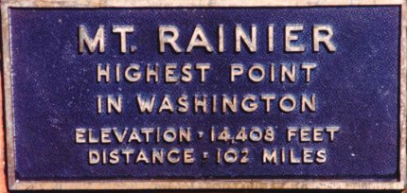
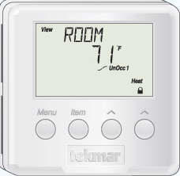
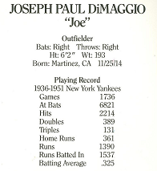
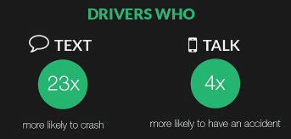

Michael Jordan’s Jersey number
Height of Mount Rainer
STATISTICS!!
Room Temperature
Joe DiMaggio’s playing record
Top 3 Colleges by SAT scores
Texting/Talking while Driving

Slide 3
Stats Program Roadmap
Stats 1: Introduction to Stats and Descriptive Analytics
Stats 2: Inferential Analytics (Hypothesis Testing
Stats 3: Advanced Analytics (Statistics)

Slide 4
Statistics – and its types
Statistics is the study of the collection, organization, analysis, and interpretation of data
Descriptive Statistics
Mean
Median
Mode
Standard Deviation
Variance
Inferential Statistics
T-test/z-test
Probability
Mode
ANOVA
Regression
Joe DiMaggio’s playing record
Texting/Talking while Driving

Slide 5
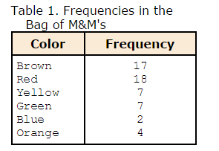
Types of data
And the weight gain from eating these MnMs?
Discrete
Continuous

Slide 6
Types of Variables
Interval: Similar to ordinal except we can say the intervals between each value are equally split.
Nominal: Refers to categorically discrete data
Ordinal: Refers to quantities that have a natural ordering.
Michael Jordan’s Jersey number
Top 3 Colleges by SAT scores
Room Temperature

Slide 7

Mean, Median and Mode (When and When not)
Mean: The mean (or average) is the most popular and well known measure of central tendency. It can be used with both discrete and continuous data, although its use is most often with continuous data (see our Types of Variable guide for data types).
Median: The median is the middle score for a set of data that has been arranged in order of magnitude.
Mode: The mode is the most frequent score in our data set.
Advantages:
Captures every point in the data set
Easy to calculate and interpret
Disadvantages:
Susceptible to Outliers
Skewed distributions can be misinterpreted
Advantages:
Less susceptible to outliers
Easy to calculate and interpret
Disadvantages:
Data needs to be ordered
Advantages:
Captures every point in the data set
Easy to calculate and interpret
Disadvantages:
Not suitable for non-discrete data sets
One data set can have multiple modes

Slide 8
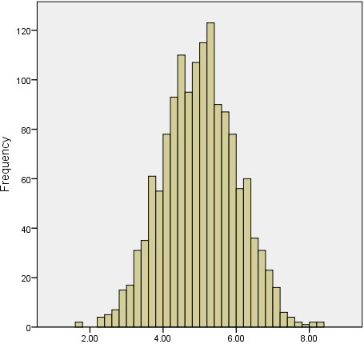
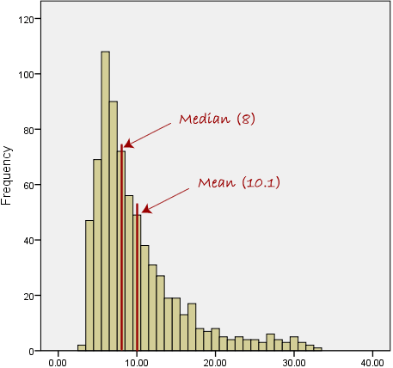
Mean v/s Median (Take it with a pinch of salt)
Use Mean
Use Median

Slide 9
Mean Vs Median
Client: “We are seeing a 14% increase in average revenue per store month over month. Our strategy seems to be paying off, lets mobilize more resources!”
Metric | Month 1 | Month 2 | MoM%
Mean Rev./Store | $4954 | $5659 | +14%
Median Rev./Store | $4500 | $2250 | -50%
WOULD YOU MOBILIZE MORE RESOURCES?

Slide 10
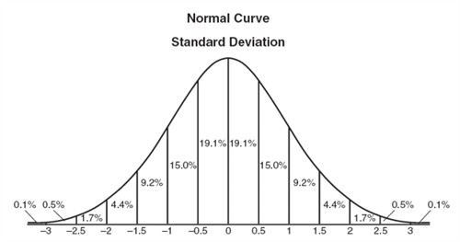

Normal distribution
Distribution of a continuous random variable. Most likely occurrence of a random sample
Completely explained by Mu-Sigma!
Eg: Per capita income in US, Weights of Seattle residents
Best measure of central tendency:
Mean = Median = Mode
95.4% of students at a school are between 1.1 m and 1.7 m tall. What would be the mean and std. deviation?

Slide 11
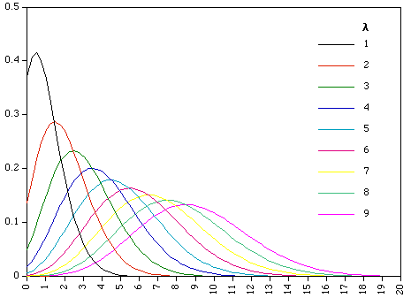
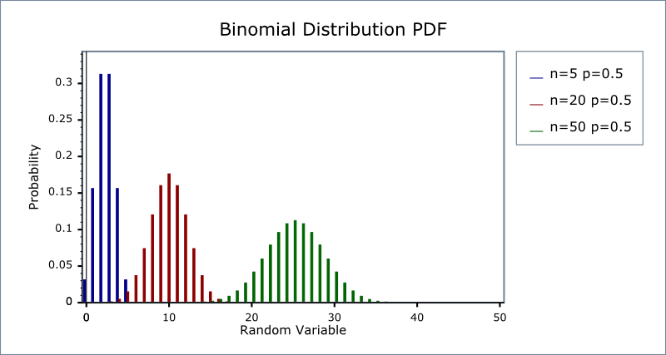
Some other distributions you will come across
Poisson Distribution
Binomial Distribution
For a discrete variable
It measures the probability that a certain number of events occur within a certain period of time. The events need to be unrelated to each other. They also need to occur with a known average rate.
Eg: number of car accidents in a given period of time
Binomial distribution with parameters n and p is the discrete probability distribution of the number of successes in a sequence of n independent yes/no experiments, each of which yields success with probability p.
Eg: number of heads from coin tosses

Slide 12
Variance and Standard Deviation
Used to measure spread of data
The variance of a data set measures the mathematical dispersion of the data relative to the mean. However, though this value is theoretically correct, it is difficult to apply in a real-world sense
The standard deviation, as the square root of the variance gives a value that is in the same units as the original values, which makes it much easier to work with and easier to interpret in conjunction with the concept of the normal curve

Slide 13
Mu + Sigma - Budget Headroom
Client: “Campaign X and Y had an average monthly budget headroom (Available Budget – Spend/Available Budget) of 25% in FY’15. Should we suggest them to use similar budget strategies for both campaigns in FY ‘16?”
Campaign Name | Jul '14 | Aug '14 | Sep '14 | Oct '14 | Nov '14 | Dec '14 | Jan '15 | Feb '15 | Mar '15 | Apr '15 | Mean | Std Dev
Camp. X | 25% | 26% | 22% | 28% | 22% | 22% | 26% | 25% | 25% | 25% | 25% | 2%
Camp. Y | 42% | 52% | 2% | 1% | 1% | 1% | 1% | 60% | 45% | 40% | 25% | 25%
Campaign X can utilize similar strategy as previous year. But the strategy for Campaign Y should be revisited/
Mean without Standard Deviation doesn’t give the complete picture

Slide 14
What’s your take?
Picking one t-shirt size for the entire Mu-Sigma Seattle Team?
“Average” weekly Utilization of delivery team in the MBR?
Per capita income in US
“Average” rainfall in Seattle
Number of push-ups Prashant does per day

Slide 15
Outlier Treatment
Definition: An outlier is an observation that is numerically far from the rest of the data points.
Viewer Discretion advised: It is for us to decide what is considered “far” or “abnormal”.
Remove at your own risk!: What you do with an outlier even if it is detected depends upon the nature of the analysis. An outlier should not be removed from the data without due consideration
Tools for treatment: Box plots can be used to do outlier treatment
Approaches for Treatment:
Elimination of specific data points: During a CPC analysis, we come across one click for which an advertiser paid $200 where as all other clicks were in the range of $3-$5. One method to do this is a box plot
Variable Capping/Flooring: Applying a minimum revenue threshold for advertisers while designing a sales initiative measurement tool

Slide 16
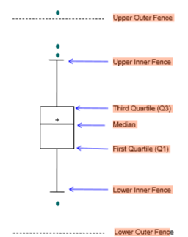
Using Box Plots to remove Outliers
Box plot gives us a statistical benchmark to determine “mild” and “extreme” outliers in data
The box plot approach can only identify outliers from an “univariate” sense
The following steps outliner the outlier detection using box plot with fences
Calculate inter-quartile range (IQR)
Calculate lower inner fence (Q1 – 1.5 × IQR)
Calculate upper inner fence (Q3 + 1.5 × IQR)
Calculate lower outer fence (Q1 – 3 × IQR)
Calculate upper outer fence (Q3 + 3 × IQR)
A mild outlier is a point beyond an inner fence on either side
An extreme outlier is a point beyond an outer fence is considered

Slide 17
Where removing outliers works
Fraud volume detection
Average Bids
Where removing outliers doesn’t work
Calculating utilization numbers

Slide 18
Think about your business….
Average CPC…is this the only way to look at CPCs?
How about mode? Median?
Would we want to look at std dev. If yes how?
Here’s what we will all do…
Pick 5 most influential metrics of your Business Group
For each of the 5 metrics, create a business context where you would use: Mean, Median, Mode, Std. Dev, Variance
Create a one slider for one metric with all possible business contexts

Slide 19
Sampling Techniques
Simple Random Sampling – A type of sampling where every unit of the population has an equal chance of being part of the sample – To generate such a sample, we need a random number generator, which generates a sequence of random numbers which are used to pick the samples (Ideal)
Eg: Someone researching on different phone users in Mu-Sigma Seattle
Stratified Random Sampling – In stratified random sampling, the whole population is divided into homogenous groups, and samples are drawn from each group with sample size proportional to the size of the group (need not always be proportional – there are other sample size allocation methods where size of sample from a strata may depend on the variance)
Eg: Someone researching on phone usage among iPhone and Andriod users in Mu-Sigma Seattle
Systematic Sampling - is easier to do than random sampling. In systematic sampling, the list of elements is "counted off". That is, every kth element is taken. This is similar to lining everyone up and numbering off "1,2,3,4; 1,2,3,4; etc". When done numbering, all people numbered 4 would be used.
Eg: A group of 500 customers attended the MuConfluence, some one wants to research customer feedback about the event

Slide 20
Sampling Techniques
Convenience Sampling – This is very easy to do, but it's probably the worst technique to use. In convenience sampling, readily available data is used. That is, the first people the surveyor runs into.
Eg: We need to conduct a research in the next 10 minutes about water drinking frequencies among adults
Cluster sampling - This is accomplished by dividing the population into groups -- usually geographically. These groups are called clusters or blocks. The clusters are randomly selected, and each element in the selected clusters are used
Eg: In a study of the opinions of employees across all engagements in the US, rather than study a few employees in every engagement, a small number of engagements are selected and a significant number of employees are selected from those engagements
Snowball Sampling: Find people to study, ask them to refer to other people who fit your study requirements
Eg: Someone wants to research latest football trends, they talk to the MuSigma Football Team captain

Slide 21
Stats Talk - 1
Population – A well defined group of individuals or observations of any size having an unique quality or characteristic, about which inferences are to be drawn
Parameter – A numeric quantity that describes a certain population characteristic. A population parameter is usually unknown and is often estimated from a sample if the population is too large. For example, the population mean is a parameter that is often used to indicate the average value of a quantity.
Sample – A group of individuals or observations selected from a particular population
Random Variable – A variable whose value results from a measurement on some type of chance or random process. In other words, a numerical description of the outcome of the experiment. E.g., height of an individual in a sample, number of patients recovering from disease in a clinical trial
Statistic – A function of the observable random variables (or in other words the sample) which is devoid of any unknown parameter. E.g., average of all heights of students in a class

Slide 22
Stats Talk - 2
Bias – Systematic favoritism that is present in the data
Mean - The mean, also referred to by statisticians as the average, is the most common statistic used to measure the center, or middle, of a numerical data set. The mean is the sum of all the numbers divided by the total number of numbers.
Median – The median is the point at which there are equal number of data points whose values lie above or below the median
Mode – The mode is the value that occurs most frequently in a data set
Standard Deviation – The standard deviation is a way statisticians use to measure the amount of variability (or spread) among the numbers in a data set. As the term implies, a standard deviation is the average amount of deviation from the mean. Square of the standard deviation known as the Variance is also used sometimes as a measure of variability
Random Sample – A sample in which every element in the population has an equal chance of being selected (not necessarily “equal”; a sample selected by a random mechanism is still called a random sample, although “equal” chance is most common)

